Slide 1
Lecture Title: Introduction & Preliminary Discussions on Algorithms
Course Code: CSC 2211
Course Title: Algorithms
Dept. of Computer Science
Faculty of Science and Technology
Lecture No: | 01 | Week No: | 01 | Semester:
Lecturer: | Name & email: Md. Manzurul Hasan, manzurul@aiub.edu

Slide 2
CSC2211 ALGORITHMS Introduction
Md. Manzurul Hasan
Assistant Professor
, Department of Computer Science
American International University-Bangladesh (AIUB)
manzurul@aiub.edu

Slide 3
Lecture Outline
Vision, Mission, Goal, Objective
Definitions
Computational Problems, Analysis, Design, and importance of Algorithms
Space & Time Complexity as parameters of performance for Algorithms including Asymptotic notations and
Preliminary data structure review

Slide 4
Vision & Mission of AIUB
Vision
AMERICAN INTERNATIONAL UNIVERSITY-BANGLADESH (AIUB) envisions promoting professionals and excellent leadership catering to the technological progress and development needs of the country.
Mission
AMERICAN INTERNATIONAL UNIVERSITY-BANGLADESH (AIUB) is committed to provide quality and excellent computer-based academic programs responsive to the emerging challenges of the time. It is dedicated to nurture and produce competent world class professional imbued with strong sense of ethical values ready to face the competitive world of arts, business, science, social science and technology.

Slide 5
Goals of AIUB
Sustain development and progress of the university
Continue to upgrade educational services and facilities responsive of the demands for change and needs of the society
Inculcate professional culture among management, faculty and personnel in the attainment of the institution's vision, mission and goals
Enhance research consciousness in discovering new dimensions for curriculum development and enrichment
Implement meaningful and relevant community outreach programs reflective of the available resources and expertise of the university
Establish strong networking of programs, sharing of resources and expertise with local and international educational institutions and organizations
Accelerate the participation of alumni, students and professionals in the implementation of educational programs and development of projects designed to expand and improve global academic standards

Slide 6
Vision & Mission of Computer Science Department
Vision
Provides leadership in the pursuit of quality and excellent computer education and produce highly skilled and globally competitive IT professionals.
Mission
Committed to educate students to think analytically and communicate effectively; train them to acquire technological, industry and research-oriented accepted skills; keep them abreast of the new trends and progress in the world of information communication technology; and inculcate in them the value of professional ethics.

Slide 7
Goals of Computer Science Department
Enrich the computer education curriculum to suit the needs of the industry- wide standards for both domestic and international markets
Equip the faculty and staff with professional, modern technological and research skills
Upgrade continuously computer hardware's, facilities and instructional materials to cope with the challenges of the information technology age
Initiate and conduct relevant research, software development and outreach services.
Establish linkage with industry and other IT-based organizations/institutions for sharing of resources and expertise, and better job opportunities for students

Slide 8
Course Objectives
The objective of this course is to teach how we can compare algorithms, the complexity analysis of time and space, effective data structure for solving difficult problems and implementation of different algorithms with the practical examples.
The purpose of the course is
a) to raise your level of sophistication in thinking about the design and analysis of algorithms;
b) learn some of the classic algorithms and recent improvements;
c) exercise your creativity in designing algorithms.

Slide 9
Course Prerequisites
Programming
Data types, operations
Conditional statements
Loops
Procedures and functions
C/ C++/ Java
Discrete Mathematics (proof theorems)
Data Structures (array, structure, pointer, file, etc...)
Computer lab (edit, compile, execute, debug)
If you lack of any of the above please refine yourselves.

Slide 10
Importance of the course
This course is a continuation of the courses Programming Language 1 & 2, and Data Structure.
Algorithm is required for all areas of computer science – especially for developing problem solving ability.
This course will give the basic for the understanding of the courses –Theory of Computation, Artificial Intelligence, etc.
This course will give the basic for the understanding of the concepts – Design and Analysis of Algorithm.

Slide 11
Course Contents
RAM model, Basic notation
Recurrences & Master Method
Dynamic Programming
Greedy strategy
Graphs Algorithms
Greedy Graph Algorithm
Shortest Path Algorithms
Basic idea of NP – Completeness
Basic idea of Elementary Geometric Methods & Review

Slide 12
Resources & References
Introduction to Algorithms, Third Edition, Thomas H. Cormen, Charle E. Leiserson, Ronald L. Rivest, Clifford Stein (CLRS).
Fundamental of Computer Algorithms, Ellis Horowitz, Sartaj Sahni, Sanguthevar Rajasekaran (HSR)
Helpful link for Problem Solving : http://acm.uva.es/problemset/
Lectures and Laboratory works will be provided online at the course website weekly.

Slide 13
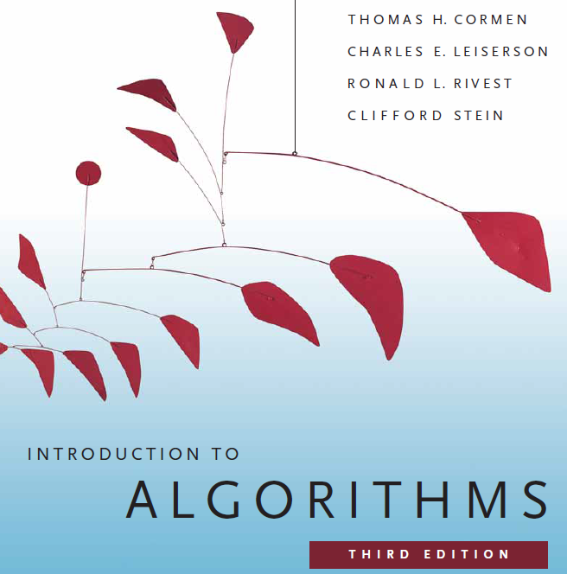

Slide 14
Course Evaluation
Midterm | Quiz (Best Two) | 25
 | Laboratory Performance/Assignment/Exam | 30
 | Class Attendance/Performance | 15
 | Midterm Written Exam | 30
 | Midterm Total | 100 | 40%
Final term | Quiz (Best Two) | 25
 | Laboratory Performance/Assignment/Exam | 30
 | Class Attendance/Performance | 15
 | Final term Written Exam | 30
 | Final Term Total | 100 | 60%
Grand Total | Final Grade of the Course |  | 100

Slide 15
Classroom Policies
Must be present inside the class in due time.
Class Break: I would prefer to start the class in due time and leave the class in 10/15 minutes early for theory/Laboratory class respectively, instead of giving a break.
Every class will start with a question-answer session about the last lecture. So students must be prepared with the contents and exercises from the last lecture.
Students are suggested to ask questions during or after the lecture.
Additional/bonus marks may be given to any good performances during the class.
Late in Class:
Student coming after 10 minutes of due time is considered late.
3 late attendances are considered as one absent.
Late during quiz/presentation are not given additional time.
Students who are regularly late might have additional deduction of marks.
A late student will be allowed to enter the class. Don’t ask permission to enter the class, just get in slowly and silently. Same policy implies if a student wants to go out of the class for emergency reasons.

Slide 16
Course Policies
Attendance
Laboratory Policies
Makeup Evaluation (quiz, assignment, etc.)
Grading Policies
Dropping a Course

Slide 17
Attendance
At least 75% presence is required by the student. Absent classes must be defended by the student through application and proper documentation to the course teacher.
Single absences or absences within 25% range will be judged by the course teacher.
Long absences/irregular presence/absences out of 25% range must go through application procedures via department Head (+ probation office, if student is in probation) to attend the following classes.
Acceptance of an application for absence only gives permission to attend the following classes. This might still result in deduction of marks (for attendance) which will be judged by the course teacher.

Slide 18
Laboratory Policies
Laboratory Classes:
First 0.5 – 1 hour will be spent explaining the problems/task/experiment to be performed.
Next 1 – 1.5 hour(s) will be spent by the students to complete the experiment.
Next 0.5 – 1 hour will be spent in checking, marking, and discussing the solution.
Students are allowed to discuss with each other (unless instructed not to) in solving problems.
But the checking (executing/viva) & marking will be with individual students only.
Laboratory Exam:
Laboratory exams are scheduled in the week before the major exams during the normal laboratory hours.
Generally students are given one/more problems to be solved of which at least one part is solved using computers.
One hour is given to the students to solve the problem. And half hour to submit and viva. Generally 20 students in the first 1.5 hours and the other 20 students in the rest 1.5 hours.
Students may be given choices to select the problem. At most 3 selection can be given to a student with 0, 2, and 4 marks deduction as a penalty for each selection respectively.
Only in case of unavoidable circumstances, the laboratory exams may be taken in the off days or week after the major exams.

Slide 19
Makeup Evaluation
There will be no makeup quiz as long as a student have appeared in 2 quizzes.
Makeup for missing evaluations like quizzes/assignment submission date/presentation date/viva date/etc., must go through valid application procedure with supporting document within the deadline of the actual evaluation date.
Makeup for missing Midterm/Final term must go through Set B form along with the supporting document within the 1st working day after exam week. The set B exam is generally scheduled from the 2nd working day after the exam week. Must get signature and exam date from the course teacher and get it approved by the department Head (monetary penalty might be imposed).
Students unable to attend the set B exam may apply for set C exam within the same time limit as set B. Such applications must be supported by very strong reason and documentation, as they are generally rejected.
The course teacher will be the judge of accepting/rejecting the request for makeup.

Slide 20
Grading Policies
All the evaluation categories & marks will be uploaded to the VUES within one week of the evaluation process except the attendance & performance, which will be uploaded along with the major (mid/final term) written exam marks.
Letter grades ‘A+’ through ‘F’ is counted as grades. Other grades ‘I’ and ‘UW’ are considered as temporary grades which are counted/calculated as ‘F’ grade in the CGPA. These grades must/will be converted to the actual grades, i.e. ‘A+’ through ‘F’.
‘I: INCOMPLETE’ is given to students who have missed at most 30% of evaluation categories (quiz/assignment/etc.). Students must contact the course teacher for makeup, through valid application procedures immediately after grade release.
‘UW: UNOFFICIAL WITHDRAW’ is given when the missing evaluation categories are too high (more than 30%) to makeup. A student getting ‘UW’ has no option but to drop the course immediately after grade release

Slide 21
Grading Policies…
Once a student’s gets ‘I’ or ‘UW’ and unable to fulfill the requirements with the course teacher for makeup, must drop the course within officially mentioned time period from the registration department.
Students in probation or falls into the probation due to ‘I’/’UW’ grade are not allowed to drop the course.
Unable to do so will result in the automatic conversion of the grades ‘I’/’UW’ to ‘F’ grade after the 4th week of the following semester.
Any problem with the mark/grade must be consulted with the course teacher within one week of the release of grades.

Slide 22
Dropping a Course
Must fill up the drop form and get it signed by the course teacher, write an application to the vice chancellor and get it signed by the department Head, and finally submit the form & application to the registration department.
The course teacher must write down the grades (if any) obtained in midterm, final, and grand total on the drop form.
No drop is accepted during the following periods:
One week before midterm exam – grade release date of midterm exam.
One week before final term exam – grade release date of final grade.
Student with ‘F’ grades in midterm, final term, or grand total cannot drop.
Probation student are not allowed to drop any course.

Slide 23
Contacts
Contact information (email, office phone extension, office location, consulting hours, etc.) of the course teacher must be stored by the students.
It is mandatory to contact/notify (preferably consulting hour/email) the course teacher for/of any problems/difficulties at the earliest possible. Late notification might not be considered.
Update & correct your email address & phone number at VUES, as the teacher will contact/notify you of anything regarding the course through these information in VUES.

Slide 24
Finally
For any problems that could not be solved/understood during the lecture, students are advised to contact during the consultation hours and solve the problem.
For any missing evaluation (quiz, assignment, etc.), classes, deadlines, etc. must contact/inform/notify the teacher immediately after missing in the consulting hour, via email, or in unavoidable circumstances – through the guardian or friend.
Probation students must meet the course teacher once a week. So schedule your time with the teacher.
Any kind of dishonesty, plagiarism, misbehavior, misconduct, etc. will not be tolerated. Might result in deduction of marks, ‘F’ grade, or reported to the AIUB Disciplinary Committee for drastic punishment.
Always check/visit the AIUB home page for notices, rules & regulations of academic/university policies and important announcement for deadlines (Course drop, Exam permit, Exam Schedule, etc.).

Slide 25
Welcome to the course
Algorithms

Slide 26
??????
What will we do/learn in this course?

Slide 27
The Goals of this Course
To think algorithmically
To understand and learn the idea behind algorithm design techniques
To get to know a toolbox of classical algorithms.
To reason (in a precise and formal way) about the efficiency and the correctness of algorithms.

Slide 28
I would request all of you to...
Be simple and precise in understanding the problem
Solve the problem first on the paper and then keyed in on the computer.
During lectures:
Interaction is welcome; ask questions.
Additional explanations and examples if desired.
Speed up/slow down the progress.

Slide 29
??????
What is Algorithm?

Slide 30
Informally
takes some value or set of values as input
produces some value or set of values, as output
Algorithm: any well-defined computational procedure
An algorithm is thus a sequence of computational steps that transform the input into the output.
Solving a given problem:
Data structure: Organization of data to solve the problem at hand.
Algorithm: Outline, the essence of a computational procedure, step-by-step instructions.
Program: Implementation of an algorithm in some programming language.

Slide 31
Kinds of Problem to be solved
Sorting and Searching are the basic and most common computational problem.
Clever algorithms are employed for the Internet
to manage large volume of data transfer.
Finding good routes on which the data will travel.
Search engine to quickly find requested pages.
Etc…
Numerical algorithms and number theory are employed in electronic commerce to keep and secure information such as credit card numbers, passwords, and bank statements.

Slide 32
Kinds of Problem to be solved
Allocating scarce resources in the most beneficial way.
An oil company may wish to know where to place its wells in order to maximize its expected profit.
A candidate may want to determine where to spend money buying campaign advertising in order to maximize the chances of winning at election.
An airline may wish to assign crews to flight in the least expensive way possible, making sure that each flight is covered and that government policy regarding crew policies are met.
Etc…

Slide 33
Algorithmic problem
Specification of output as a function of input
Specification of input
Algorithm
Finite number of input instances satisfying the specification.
For example:
A sorted, non-decreasing sequence of natural numbers. The sequence is of non-zero, finite length:
1, 20, 908, 909, 100000, 1000000000.
3.

Slide 34
Algorithmic Solution
Input instance, adhering to the specification
Output related to the input as required
Algorithm
Algorithm describes actions on the input instance.
There may be many correct algorithms for the same algorithmic problem.
Introduction→34

Slide 35
Definition of an Algorithm
An algorithm is a sequence of unambiguous instructions for solving a problem, i.e., for obtaining a required output for any legitimate input in a finite amount of time.
Properties:
Precision
Determinism
Finiteness
Efficiency
Correctness
Generality

Slide 36
Overall Picture
Using a computer to help solve
problems.
Precisely specify the problem.
Designing programs
Architecture → data structure
Technique → algorithms
Writing programs
Verifying (testing) programs
Data Structure and Algorithm Design Goals
Correctness
Efficiency
Implementation Goals
Adaptability
Reusability
Robustness

Slide 37
How to Develop an Algorithm?
Precisely define the problem.
Precisely specify the input and output.
Consider all cases.
Come up with a simple plan to solve the problem at hand.
The plan is language independent.
The precise problem specification influences the plan.
Turn the plan into an implementation
The problem representation (data structure) influences the implementation.

Slide 38
??????
Suppose computers were infinitely fast and computer memory was free. Would you have any reason to study algorithms?

Slide 39
Algorithm
Analysis

Slide 40
Analysis of Algorithms
Efficiency:
Running time
Space used
Efficiency as a function of the input size:
Number of data elements (numbers, points).
The number of bits of an input number .

Slide 41
The RAM Model
RAM model represents a “generic” implementation of the algorithm
Each “simple” operation (+, -, =, if, call) takes exactly 1 step.
Loops and subroutine calls are not simple operations, but depend upon the size of the data and the contents of a subroutine. We do not want “sort” to be a single step operation.
Each memory access takes exactly 1 step.
Notes:
Basically, any basic operation that takes a small, fixed amount of time we assume to take just one step.
We measure the run time of an algorithm by counting the number of steps it takes.
Why does this work? For the same reason that the “Flat Earth” model works. In our day-to-day lives we assume the Earth to be flat!
Now, lets look at how we can use this.

Slide 42
The RAM model (cntd..)
It is important to choose the level of detail.
The RAM model:
Instructions (each taking constant time), we usually choose one type of instruction as a characteristic operation that is counted:
Arithmetic (add, subtract, multiply, etc.)
Data movement (assign)
Control flow (branch, subroutine call, return)
Comparison (logical ops)
Data types – integers, characters, and floats

Slide 43
Example
Algorithm arrayMax(A, n)
# operations
currentMax ← A[0] 2
for (i =1; i<n; i++) 2n
(i=1 once, i<n n times, i++ (n-1) times)
if A[i] > currentMax then 2(n − 1)
currentMax ← A[i] 2(n − 1)
return currentMax 1
Total 6n −1

Slide 44
Example: N-by-N matrix, N-by-1 vector, multiply
Y = zeros(N,1);
for i=1:N
Y(i) = 0.0;
for j=1:N
Y(i) = Y(i) + A(i,j)*x(j);
end
end
(3 accesses, 1 add, 1 multiply)
initialize space, c₁N
initialize “for” loop, c₂N
Scalar assignment, c₃
initialize “for” loop, c₂N
c₄
N times
N times
End of loop, return/exit, c₅
End of loop, return/exit, c₅
Total = c₁N+c₂N+N(c₃+c₂N+N(c₄+c₅)+c₅)
= (c₂+c₄+c₅)N² + (c₁+c₂+c₃+c₅)N
= c₆N² + c₇N

Slide 45
Time complexity familiar tasks
Task
Matrix/vector multiply
Getting a specific element from a list
Dividing a list in half, dividing one halve in half, etc
Binary Search
Scanning (brute force search) a list
Nested for loops (k levels)
MergeSort
BubbleSort
Generate all subsets of a set of data
Generate all permutations of a set of data
Growth rate
O(N²)
O(1)
O(log₂N)
O(log₂N)
O(N)
O(N^{k})
O(N log₂N)
O(N²)
O(2^{N})
O(N!)

Slide 46
Insertion Sort
while some elements unsorted:
Using linear search, find the location in the sorted portion where the 1st element of the unsorted portion should be inserted
Move all the elements after the insertion location up one position to make space for the new element
45
38
60
45
66
60
45
66
79
47
13
74
36
21
94
22
57
16
29
81
the fourth iteration of this loop is shown here

Slide 47
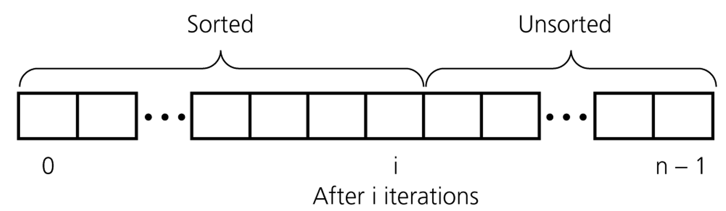
An insertion sort partitions the array into two regions

Slide 48
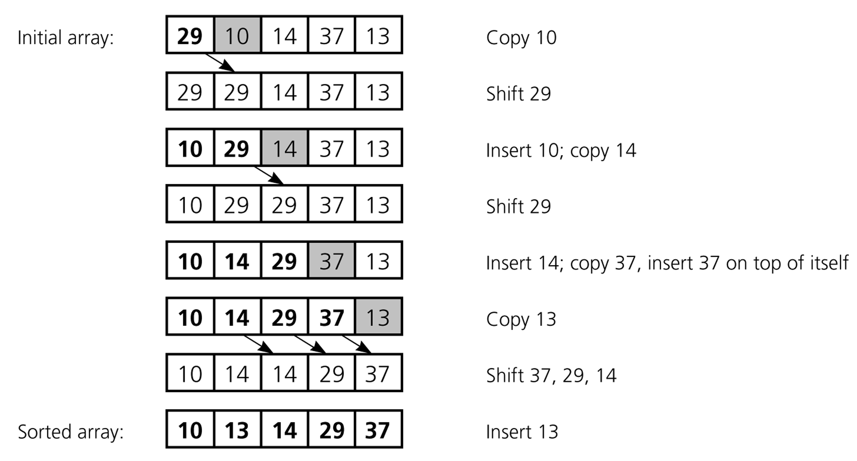
An insertion sort of an array of five integers

Slide 49
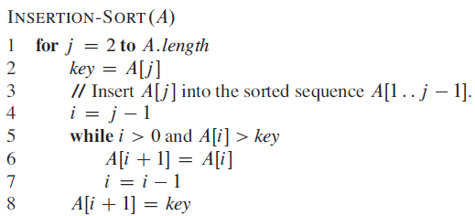
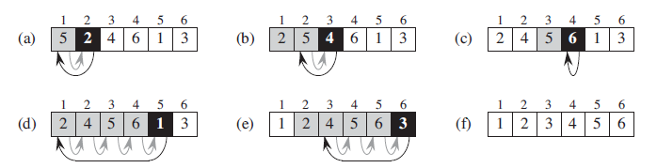
Insertion Sort

Slide 50
Loop invariants and the correctness of insertion sort
Loop Invariant: is a property of a program loop that is true before (and after) each iteration.
Initialization: It is true prior to the first iteration of the loop.
Maintenance: If it is true before an iteration of the loop, it remains true before the next iteration.
Termination: When the loop terminates, the invariant gives us a useful property that helps show that the algorithm is correct.

Slide 51
Analysis of Insertion Sort
Time to compute the running time as a function of the input size (exact analysis).
for j := 2 to n do
key := A[j]
// Insert A[j] into A[1..j-1]
i := j-1
while i>0 and A[i]>key do
A[i+1]:=A[i]
i--
A[i+1]:=key
cost c₁
c₂
0
c₃
c₄
c₅
c₆
c₇
times n n-1 n-1 n-1 n-1

Slide 52
…Analysis of Insertion Sort
The running time of an algorithm is the sum of the running times of each statement.
A statement with cost c that is executed n times contributes c*n to the running time.
The total running time T(n) of insertion sort is
T(n)= c₁*n + c₂(n-1) + c₃(n-1) + c₄ + c₅ + c₆
+ c₇ (n-1)

Slide 53
…Analysis of Insertion Sort
Often the performance depends on the details of the input (not only the length n).
This is modeled by t_{j.}
In the case of insertion sort the time t_{j} depends on the original sorting of the input array.

Slide 54
Performance Analysis
Performance often draws the line between what is feasible and what is impossible.
Often it is sufficient to count the number of iterations of the core (innermost) part.
No distinction between comparisons, assignments, etc (that means roughly the same cost for all of them).
Gives precise enough results.
In some cases the cost of selected operations dominates all other costs.
Disk I/O versus RAM operations.
Database systems.

Slide 55
Best/ Worst/ Average Case
Best case: works fast on some input.
Worst case: (usually) maximum time of algorithm on any input of size.
Average case: (sometimes) expected time of algorithm over all inputs of size. Need assumption of statistical distribution of inputs.
Analyzing insertion sort’s
Best case: elements already sorted, t_{j}=1, running time ≈ (n-1), i.e., linear time.
Worst case: elements are sorted in inverse order, t_{j} = j-1, running time ≈ (n²-n)/2 , i.e., quadratic time.
Average case: t_{j} = j / 2, running time ≈ (n²+n-2)/4 , i.e., quadratic time.

Slide 56
…Best/ Worst/ Average Case
For inputs of all sizes:
worst-case
6n
average-case
5n
best-case
Running time
4n
3n
2n
1n
1 2 3 4 5 6 7 8 9 10 11 12 …..
Input instance size

Slide 57
…Best/ Worst/ Average Case
Worst case is usually used:
It is an upper-bound.
In certain application domains (e.g., air traffic control, surgery) knowing the worst-case time complexity is of crucial importance.
For some algorithms worst case occurs fairly often
The average case is often as bad as the worst case.
Finding the average case can be very difficult.

Slide 58
Asymptotic Notation
Asymptotic Notations are languages that allow us to analyze an algorithm's running time by identifying its behavior as the input size for the algorithm increases.
This is also known as an algorithm's growth rate.(Wiki)

Slide 59
Asymptotic Notation
The “big-Oh” O-Notation
asymptotic upper bound
f(n) = O(g(n)), if there exists constants c>0 and n₀>0, s.t. f(n) ≤ c g(n) for n ≥ n₀
f(n) and g(n) are functions
over non- negative integers
Used for worst-case analysis
Running Time
Input Size

Slide 60
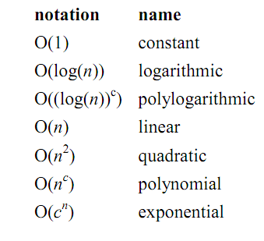
Asymptotic Notation

Slide 61
...Asymptotic Notation
The “big-Omega” Ω−Notation
asymptotic lower bound
f(n) = Ω(g(n)) if there exists constants c>0 and n₀>0, s.t. c g(n) ≤ f(n) for n ≥ n₀
Used to describe best-case running times or lower bounds of algorithmic problems.
E.g., lower-bound of searching in an unsorted array is Ω(n).
Running Time
Input Size

Slide 62
...Asymptotic Notation
The “big-Theta” Θ−Notation
asymptoticly tight bound
f(n) = Θ(g(n)) if there exists constants c₁>0, c₂>0, and n₀>0, s.t. for n ≥ n₀ c₁ g(n) ≤ f(n) ≤ c₂ g(n)
f(n) = Θ(g(n)) if and only if f(n) = Ο(g(n)), f(n) = Ω(g(n))
O(f(n)) is often abused instead of Θ(f(n))
Running Time
Input Size

Slide 63
Asymptotic Analysis
Goal: to simplify the analysis of the running time by getting rid of details, which are affected by specific implementation and hardware
rounding of numbers: 1,000,001 ≈ 1,000,000
rounding of functions: 3n² ≈ n²
Capturing the essence: how the running time of an algorithm increases with the size of the input in the limit.
Asymptotically more efficient algorithms are best for all but small inputs

Slide 64
...Asymptotic Analysis
Simple Rule: Drop lower order terms and constant factors.
50 n log n is O(n log n)
7n - 3 is O(n)
8n² log n + 5n² + n is O(n² log n)
Note: Although (50 n log n) is O(n⁵), it is expected that an approximation is of the smallest possible order.

Slide 65
Correctness of Algorithms
An algorithm is correct if for any legal input it terminates and produces the desired output.
Automatic proof of correctness is not possible (so far).
There are practical techniques and rigorous formalisms that help to reason about the correctness of (parts of) algorithms.

Slide 66
Partial and Total Correctness
Partial correctness
IF this point is reached,
THEN this is the desired output
Any legal input
Algorithm
Output
Total correctness
INDEED this point is reached,
AND this is the desired output
Any legal input
Algorithm
Output

Slide 67
Assertions
To prove partial correctness we associate a number of assertions (statements about the state of the execution) with specific checkpoints in the algorithm.
E.g., A[1], …, A[ j ] form an increasing sequence
Preconditions – assertions that must be valid before the execution of an algorithm or a subroutine (INPUT).
Postconditions – assertions that must be valid after the execution of an algorithm or a subroutine (OUTPUT).

Slide 68
Pre/post-conditions
Example:
Write a pseudocode algorithm to find the two smallest numbers in a sequence of numbers (given as an array).
INPUT: an array of integers A[1..n], n > 0
OUTPUT: (m1, m2) such that
m1<m2 and for each i∈[1..n]: m1 ≤ A[i] and, if A[i] ≠ m1, then m2 ≤ A[i].
m2 = m1 = A[1] if ∀j,i∈[1..n]: A[i]=A[j]

Slide 69
Loop Invariants
Invariants: assertions that are valid any time they are reached (many times during the execution of an algorithm, e.g., in loops)
We must show three things about loop invariants:
Initialization: it is true prior to the first iteration.
Maintenance: if it is true before an iteration, then it is true after the iteration.
Termination: when a loop terminates the invariant gives a useful property to show the correctness of the algorithm

Slide 70
Example: Binary Search
l := 1
r := n
do
m := ⎣(l+r)/2⎦
if A[m] = q then return m
else if A[m] > q then r := m-1
else l := m+1
while l <= r
return NIL
We want to show that q is not in A if NIL is returned.
Invariant: ∀i∈[1..l-1]: A[i]<q (Ia)
∀i∈[r+1..n]: A[i]>q (Ib)
Initialization: l = 1, r = n the invariant holds because there are no elements to the left of l or to the right of r.
l=1 yields ∀j,i ∈[1..0]: A[i]<q this holds because [1..0] is empty
r=n yields ∀j,i ∈[n+1..n]: A[i]>q this holds because [n+1..n] is empty

Slide 71
…Example: Binary Search
l := 1
r := n
do
m := ⎣(l+r)/2⎦
if A[m] = q then return m
else if A[m] > q then r := m-1
else l := m+1
while l <= r
return NIL
Invariant: ∀i∈[1..l-1]: A[i]<q (Ia) ∀i∈[r+1..n]: A[i]>q (Ib)
Maintenance: l, r, m = ⎣(l+r)/2⎦
A[m]!=q & A[m]>q, r=m-1, A sorted implies ∀k∈[r+1..n]: A[k]>q (Ib)
A[m]!=q & A[m]<q, l=m+1, A sorted implies ∀k∈[1..l-1]: A[k]<q (Ia)

Slide 72
…Example: Binary Search
Invariant: ∀i∈[1..l-1]: A[i]<q (Ia) ∀i∈[r+1..n]: A[i]>q (Ib)
l := 1
r := n
do
m := ⎣(l+r)/2⎦
if A[m] = q then return m
else if A[m] > q then r := m-1
else l := m+1
while l <= r
return NIL
Termination: l, r, l<=r
Two cases:
l:=m+1 we get ⎣(l+r)/2⎦ +1 > l
r:=m-1 we get ⎣(l+r)/2⎦ -1 < r
The range gets smaller during each iteration and the loop will terminate when l<=r no longer holds.

Slide 73
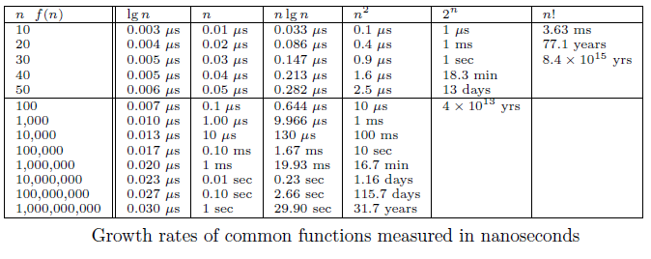
Growth Rates and Dominance Relations

Slide 74
Proof by Induction
We want to show that property P is true for all integers n ≥ n₀.
Basis: prove that P is true for n₀.
Inductive step: prove that if P is true for all k such that n₀ ≤ k ≤ n – 1 then P is also true for n.
Example
Basis

Slide 75
...Proof by Induction
Inductive Step

Slide 76
Sorting
Sorting is a classical and important algorithmic problem.
We look at sorting arrays (in contrast to files, which restrict random access).
A key constraint is the efficient management of the space
In-place sorting algorithms
The efficiency comparison is based on the number of comparisons (C) and the number of movements (M).

Slide 77
Sorting
Simple sorting methods use roughly n * n comparisons
Insertion sort
Selection sort
Bubble sort
Fast sorting methods use roughly n * log n comparisons.
Merge sort
Heap sort
Quicksort

Slide 78
References & Readings
CLRS
Chapters: 1, 2 (2.1, 2.2), 3
Exercises: 1.2-2, 1.2-3, 2.1-3, 2.1-4, 2.2-1, 2.2-3, 3.1-1, 3.1-4, 3.1-6, 3.1
Problems: 1-1, 3-3
HSR
Chapters: 1 (1.1-1.3)
Examples: 1.4-1.6, 1.11-1.13, 1.17-1.18
Exercises: 1.3 (1-4, 8, 9)
Review for laboratory
HSR
Chapters: 2, 3.2 - 3.5
CLRS
Chapters: 6, 7, 10, 12

